Slide 1
Python Function
Practice

Slide 2
Python - Function
A function is a block of organized, reusable code that is used to perform a single, related action.
Functions provides better modularity for your application and a high degree of code reusing.
As you already know, Python gives you many built-in functions like print() etc. but you can also create your own functions. These functions are called user-defined functions.

Slide 3
Rules to define a Function
Function blocks begin with the keyword def followed by the function name and parentheses ( ( ) ).
Any input parameters or arguments should be placed within these parentheses. You can also define parameters inside these parentheses.
The first statement of a function can be an optional statement - the documentation string of the function or docstring.

Slide 4
…Rules to define a Function
The code block within every function starts with a colon (:) and is indented.
The statement return [expression] exits a function, optionally passing back an expression to the caller. A return statement with no arguments is the same as return None.

Slide 5
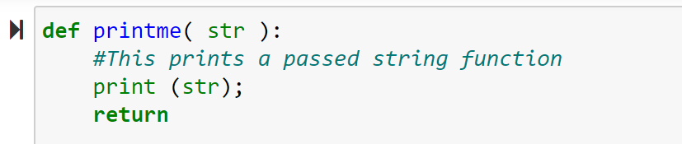

Syntax: Function
Syntax:
def functionname( parameters ):
"function_docstring"
function_suite
return [expression]
By default, parameters have a positional behavior, and you need to inform them in the same order that they were defined.
Example:

Slide 6
Why Functions?
Creating a new function gives you an opportunity to name a group of statements, which makes your program easier to read and debug.
Functions can make a program smaller by eliminating repetitive code. Later, if you make a change, you only have to make it in one place.
Dividing a long program into functions allows you to debug the parts one at a time and then assemble them into a working whole.
Well-designed functions are often useful for many programs. Once you write and debug one, you can reuse it.

Slide 7
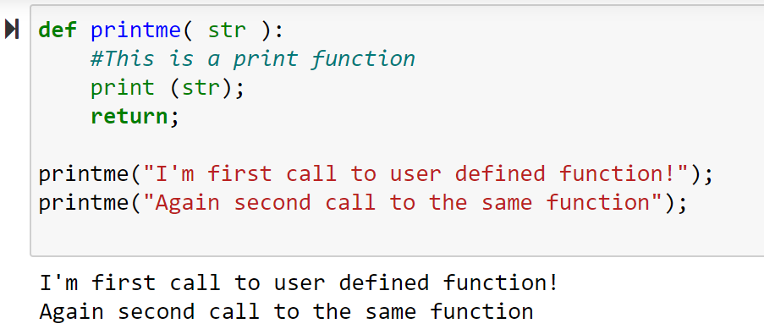
Calling a Function
Week_7/practice.ipynb/cell_1

Slide 8
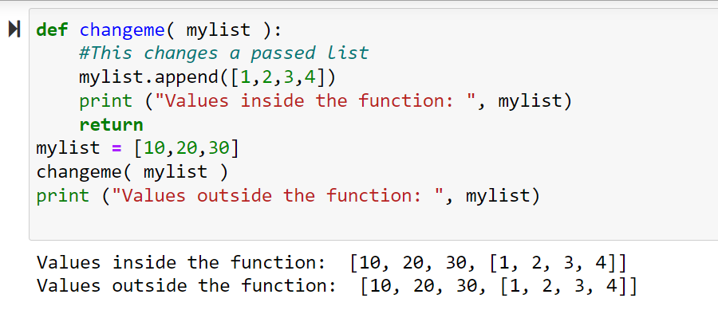
Pass by reference vs value
All parameters (arguments) in the Python language are passed by reference.
It means if you change what a parameter refers to within a function, the change also reflects back in the calling function.
Week_7/practice.ipynb/cell_2

Slide 9
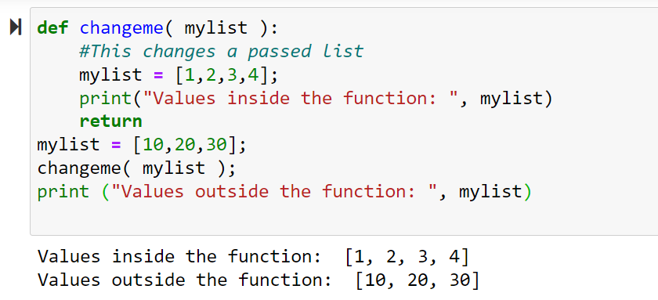
Pass by reference vs value
There is one more example where argument is being passed by reference but inside the function, but the reference is being over-written.
Week_7/practice.ipynb/cell_3

Slide 10
Function Arguments
A function operates by using the following types of formal arguments::
Required arguments
Keyword arguments
Default arguments
Variable-length arguments

Slide 11
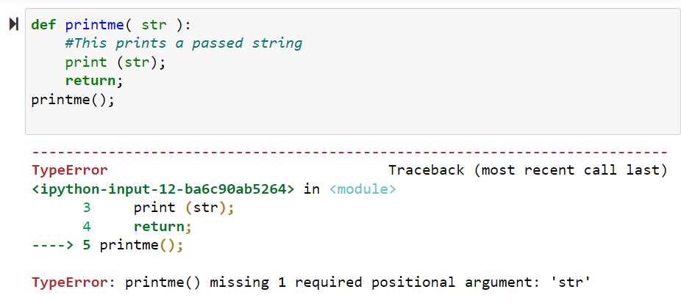
Required Arguments
Required arguments are the arguments passed to a function in correct positional order.
Week_7/practice.ipynb/cell_4

Slide 12
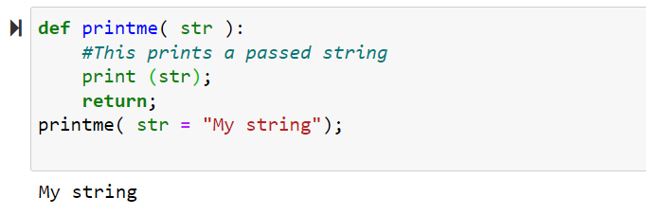
Keyword Arguments
Keyword arguments are related to the function calls. When you use keyword arguments in a function call, the caller identifies the arguments by the parameter name.
This allows you to skip arguments or place them out of order because the Python interpreter is able to use the keywords provided to match the values with parameters.
Week_7/practice.ipynb/cell_4

Slide 13
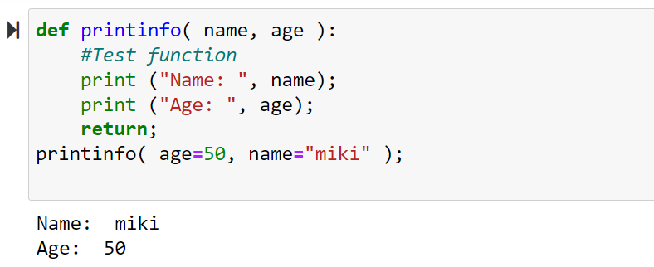
Keyword Arguments
A more clear picture.
Note, here order of the parameter does not matter:
Week_7/practice.ipynb/cell_5

Slide 14
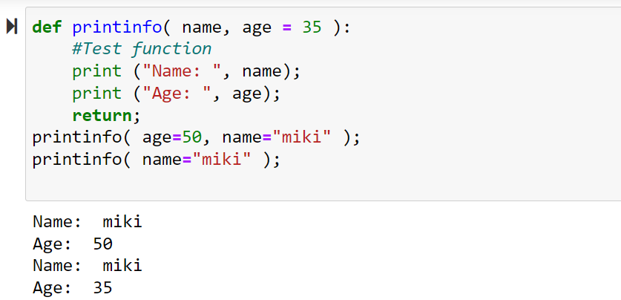
Default Arguments
A default argument is an argument that assumes a default value if a value is not provided in the function call for that argument.
Week_7/practice.ipynb/cell_6

Slide 15
Variable Arguments
You may need to process a function for more arguments than you specified while defining the function. These arguments are called variable-length arguments and are not named in the function definition, unlike required and default arguments.
The general syntax for a function with non-keyword variable arguments is this:
def functionname([formal_args,] *var_args_tuple ):
"function_docstring"
function_suite
return [expression]

Slide 16
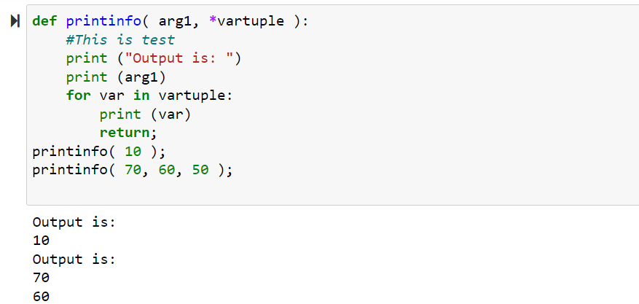
Variable Arguments
An asterisk (*) is placed before the variable name that will hold the values of all non-keyword variable arguments. This tuple remains empty if no additional arguments are specified during the function call.
Week_7/practice.ipynb/cell_7

Slide 17
Scope of Variables
All variables in a program may not be accessible at all locations in that program. This depends on where you have declared a variable.
The scope of a variable determines the portion of the program where you can access a particular identifier. There are two basic scopes of variables in Python:
Global variables
Local variables
Global vs. Local variables:
Variables that are defined inside a function body have a local scope, and those defined outside have a global scope.
This means that local variables can be accessed only inside the function in which they are declared whereas global variables can be accessed throughout the program body by all functions. When you call a function, the variables declared inside it are brought into scope.

Slide 18
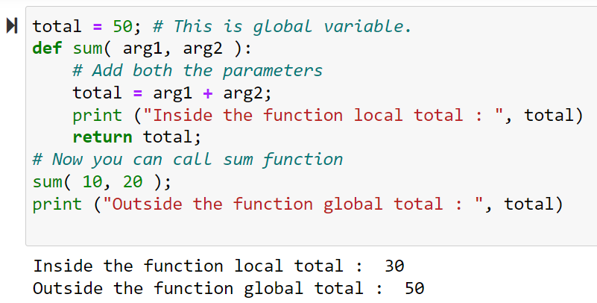
Scope of Variables
Week_7/practice.ipynb/cell_9

Slide 19
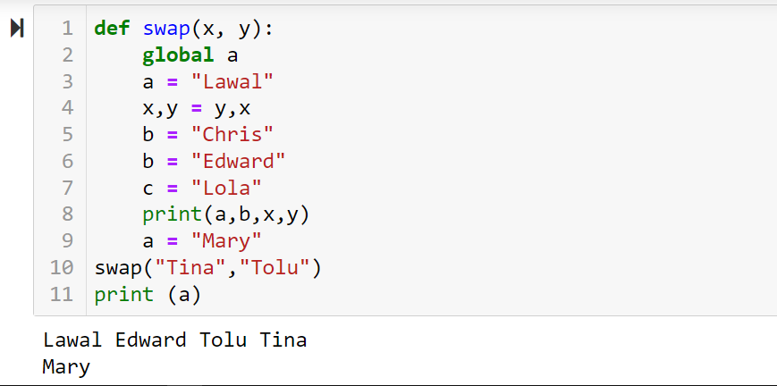
Scope of Variables
Week_7/practice.ipynb/cell_10

Slide 20
Class Projects

Slide 21
Project I
One of the key issue that have threatened organizations and institutions is that of name verification. To solve it, people now use biometric software and machine vision enabled tools to verify identities of their employees and take attendance. JT Ventures is a delivery business, with about 40 employees. However, the management board would want a way to identify if a user is one of her employees. Your mission, should you choose to accept it, is to write a python function program that takes a user's name and department, then checks if he/she is an employee. If employee exist, then welcome the employee appropriately and display the company profile (jt-ventrues.csv dataset is attached) ….otherwise, you politely indicate that employee does not exist.

Slide 22
Project II
Gboyega Adekunle runs a delivery service called Yega Services, and charge people based on their location and weight of their package. The following are some of the things he considers:
He charges N2,000, whenever he is delivering a package with weight of 10kg and above to Ibeju-Lekki community, and N1500 when it is less.
However, he charges N5,000 whenever he delivers to Epe, a package with weight of 10kg and above, and N4,000 when it is less.
Write a python function program that tells a user how much to pay, based on their location, and package weight.

Slide 23
Project III
Before an individual is admitted into Computer Science Department, he/she must:
Score 230 or above in jamb
Have at least 5 credit in the 5 key subjects (you know them)
Pass an interview.
Your mission, should you choose to accept it, is to automate this process, by developing a python function program that tells a particular candidate if he/she is admitted into computer science, based on their inputs. The program will store the information of candidates who are admitted into a file called admitted.csv, and candidates who did not meet the requirements are stored in another file called not-admitted.csv
Before an individual is admitted into Mass Communication Department, he/she must:
Score 220 or above in jamb
Have at least 5 credit in the 5 key subjects (you know them)
Pass an interview.

